Slide 1



Particle Swarm Optimization
♦ Priyanka Vyas ♦
♦ Wayne Fincher ♦

Slide 2
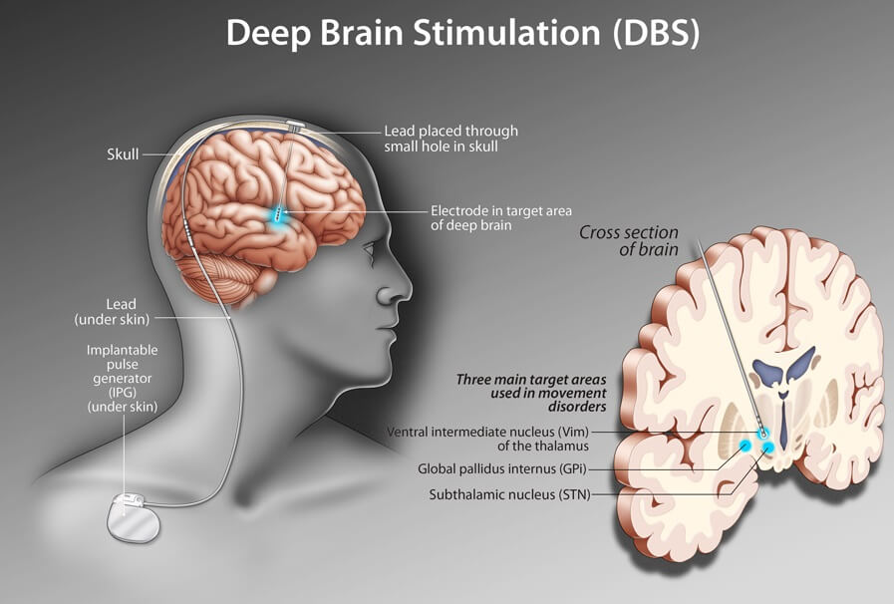
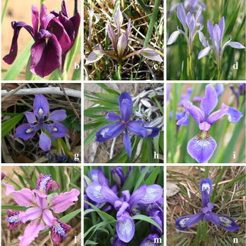


PSO Application Areas Studied
Fuzzy Neural Networks
Classification of Iris Species
Parkinson’s Disease Prediction
Notes:
Parkinson Disease prediction:
-Goal is to extend the battery life of deep brain stimulator by introducing tremor onset prediction using radical based function neural network.
-DBS targets parts of brain that play a role in control of movement.
-To train this network, we study stimulation signals that are used to treat Parkinson disease. In this application we focus on LFP signals from subthalamic nucleus which helps direct movement preparation.
-These LFP datasets are obtained through deep brain electrode implanted in a Parkinson patient.
Fuzzy Neural Networks: Classification of Iris Species
Given a set of flowers with various attributes, linguistic quantification is used to obtain fuzzy set membership which is then input to a feed forward neural network. The PSO method is then used train the network by optimizing the parameters of the set membership functions and the neural network weights. Once the fuzzy neural network is trained, the model is used to classify the particular species of Iris for the remaining flowers in the dataset.

Slide 3
Fundamentals of Metaheuristics and Parameters of PSO
Objective function:
Position vector:
Velocity vector:
Position function:
Velocity function:
Inertia weight constant:
Cognitive coefficient:
Local optima position:
Global optima position:
Social coefficient:
Notes:
Fundamentals of Metaheuristics and Parameters (1 minute)
PSO -> Inspired by the movement of flocks of birds and schools of fish.
Each animal is considered as a point particle in D dimensional space.
It is important to note that any time there is a superscript of “i”, we are referencing the i^th particle.
The number of particles determines the amount of parallelism in computing the objective function.
Also note that all vector quantities are denoted with a bar on top.
The objective function maps the D dimensional real valued space to a single real number or possibly a real valued vector with D’ dimensions.
Since we view the particles as moving in space, we will consider a position vector x and velocity vector v – for each particle.
Time is considered in integer increments. The position at time t+1 is x(t) + v(t+1).
The velocity vector is where things get interesting. To calculate v(t+1), there are three terms.
ADVANCE ANIMATION
The first term is the velocity at time “t” and can be thought of as the inertia of the particle. The constant “w” controls the influence of inertia on the partile.
ADVANCE ANIMATION
The vector p*i is the position of the ith particle which has the optimal value that particle has found so far. The second term is found by taking the difference of p*i and the particle’s current position. The constant c1 combined with the random value r1 controls the influence of the “cognitive” term, which is thought of as the particle’s tendency to return to a position which was desirable.
ADVANCE ANIMATION
The vector g* is the best of p* positions from all particles so far. This is thought of as the social influence on a particle from other particles. Again, we take the difference of g* and the ith particle’s current position, scaled by a constant c2 and random value r2, thus controlling the influence of the social term on the movement of the particle.
#############################################
Particle Swarm Optimization (PSO) is an evolutionary computation technique developed by Eberhart and Kennedy.19. It simulates the food searching activities of a swarm of birds (particles). In the multidimensional space in which each particle represents a point at the intersection of all search dimensions, each particle in the swarm is moved toward the optimal point by adding a velocity to its position. The velocity of a particle is updated by three components, which are called inertial, cognitive, and social. 1. The inertial component is the simulation of the inertial behavior of the bird to continue flying in the same direction. i.e. Inertia weight 2. Meanwhile the memory of the bird about its previous best position is modeled by the cognitive component model, i.e. Cognitive Coefficient 3. And; the memory of the bird about the best position among the particles (interaction inside the swarm) is modeled by the social component i.e. Social Coefficient The particles move around the multidimensional search space until they find the food (optimal solution) and in our application it is defined as g best i.e. global optima position.
https://latexeditor.lagrida.com/
\overline{x}^i = (x_1^i, x_2^i, \dots, x_D^i)
\overline{v}^i = (v_1^i, v_2^i, \dots, v_D^i)
\overline{x}^i(t+1) = \overline{x}^i(t) + \overline{v}^i(t+1)
\overline{v}^i(t+1) = w\,\overline{v}^i(t) + c_1r_1\left(\overline{p}^{*i} - \overline{x}^i(t)\right) + c_2r_2\left(\overline{g}^* - \overline{x}^i(t)\right)
f:\mathbb{R}^D\to \mathbb{R}

Slide 4
Metaheuristics Variations for
Fuzzy Neural Network (FNN) w/PSO
Iris Species Classification
No “inertia”term
Velocity function:
Just instead of and
Position is best out of the particle’s neighbors
Maximum velocity:
Notes:
Metaheuristics Variations Description for Application 1 (2 minutes)
Turning now to the application of PSO to iris species classification, we will first detail changes made to the PSO algorithm to suit the problem domain.
ADVANCE ANIMATION
Classifying iris species has metaheuristic motivations which contrast to a certain extent with those of vanilla PSO. Rather than viewing the particles moving through the search space as a flock of birds, it is viewed as neurons in the brain working together to think of a solution. Therefore, the inertia term is dropped, but not without experimental evidence to do so. It was found by Zhenya, et al that PSO without the inertia term was more performant on certain test functions.
ADVANCE ANIMATION
The cognitive and social terms have c1 = c2, and the constant, therefore, simply acts to scale the change in position. The scale of the cognitive and social terms are slightly randomized independently.
ADVANCE ANIMATION
The social term has been limited to only take into account the p* from the ith particle’s neighbors. In this work, it was considered that ith-1 and ith+1 particles are the extent of the neighborhood, thus forming an equivalence with the "circle" communication pattern.
ADVANCE ANIMATION
Lastly, the change in position is globally limited by v_max in order to prevent computational overflow.
#############################################
\overline{v}^i(t+1) = c\,r_1\left(\overline{p}^{*i} - \overline{x}^i(t)\right) + c\,r_2\left(\overline{n}^{*i} - \overline{x}^i(t)\right)
\left|\overline{v}^i(t)\right| = \min(\left|\overline{v}^i(t)\right|, v^{max})

Slide 5

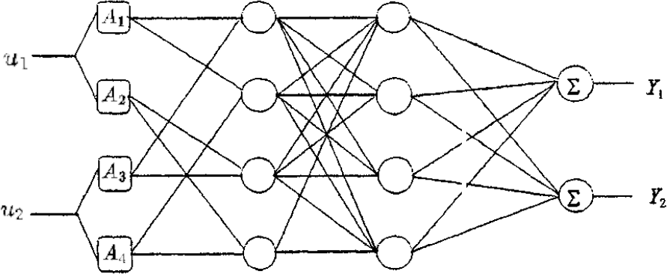

FNN w/PSO Architecture
Iris Species Classification
Flower characteristics for each flower
Let the function
be defined as
using the neural network below.
Sepal length….
Sepal width….
Petal length….
Petal width….
Iris Species
Setosa….
Versicolor….
Virginica….
Notes:
Now we turn our attention to a discussion of the architecture of the fuzzy neural network. First, let us consider the essentials of a feed forward neural network. In the graph pictured below, we see four sets of nodes which are vertically aligned. These correspond to layers in the neural network, with the first layer the input layer, the last layer the output layer, and the intervening layers considered as hidden layers since they operate as a black box inside the network. The edges of the network are considered as weights or parameters and each node computes a value. The value from a neuron is combined with the weights from outgoing connections and ingested via incoming connections to the neurons in the next layer. In this way, a series of calculations occurs starting from the input layer to the output layer. The network in and of itself can be considered as a mathematical function.
For iris species classification, we have a set of flowers U, each with attributes specified by a vector u. This vector is the input to the network. Each of the attributes is a component of the vector u and can be specified in a linguistic manner. For example: The sepal length is “quite long” or “very short”. Each linguistic unit is assigned a value, essentially arbitrarily. The input layer of the network is composed of membership functions which have parameters to be trained. Each component is fed into two membership functions. Thus, the vector u, which has four components is fed into an input layer of eight membership functions or neurons which test the attribute for full or partial membership in a set by assigning a real value from 0 to 1. The output layer consists of three neurons corresponding to the three iris species in consideration and will output a value from 0 to 1, with higher numbers indicating higher confidence of the flower being classified as the species associated with that output neuron. The membership function parameters and all of the edge weights are considered as a vector x in capital X, i.e., a particle in R D space.
With those preliminaries out of the way, we now proceed to mathematically describe the network which is a function FNN which maps the set of flower characteristics U and the set of parameters X to an output space Y. In particular, FNN takes a vector u of flower characteristics and a vector x of membership parameters and edge weights and outputs a vector y detailing the flower’s predicted classification into iris species’.
#############################################
Problem Specification of Application 1 (1 minute)
W_1,\,W_2\,,W_3
\begin{bmatrix}
u_{1} \\
u_{2} \\
u_{3} \\
u_{4}
\end{bmatrix} = \overline{u}
\overline{u} \in U
\begin{bmatrix}
y_{1} \\
y_{2} \\
y_{3}
\end{bmatrix}^i = \overline{y}^i
A_j^i(u) = \frac{1}{1+ \left(\left(\frac{u-\gamma_j^i}{\alpha_j^i}\right)^2\right)^{\beta_j^i}}
\eta \in H
FNN(\overline{u},\overline{x}^i) = \overline{y}^i
FNN: U \cup X \rightarrow Y

Slide 6

FNN w/PSO Parameters
Iris Species Classification
Each particle
has parameters:
Total parameters per particle: 128
Flower features input into
two membership functions:
Membership function
defined as:
Notes:
Issues and Parameters in Application 1 (2 minutes)
Below, we see the form of the membership function which takes one feature of the flower as input and outputs a number from 0 to 1. There are three parameters for each of the eight membership functions which all need to be optimized. Additionally, there are three weight matrices, corresponding to edges between layers. In all, this gives 128 parameters–which is to say our particles will be flying in 128 dimensional space.
#############################################
\alpha_{1:8}^i,\,\beta_{1:8}^i,\gamma_{1:8}^i,\, W_1^{i,8\cross2},\, W_2^{i,8\cross8},\, \text{and }\, W_3^{i,8\cross3}
\alpha_{1:8}^i,\,\beta_{1:8}^i,\gamma_{1:8}^i
\alpha_{k}^i,\,\beta_{k}^i,\gamma_{k}^i
\alpha_{k+1}^i,\,\beta_{k+1}^i,\gamma_{k+1}^i
A_{k+1}^i

Slide 7
FNN w/PSO Training Method
Iris Species Classification
Train the network
Form two groups from U and use one for training
For each , randomize the parameters (all 128)
Compute for each particle
If some indicates the correct species, STOP, else, CONTINUE
Apply PSO to compute new parameters and GOTO 3
Notes:
Mapping parameters in Application 1 (2 minutes)
The process of optimizing those 128 parameters is called "training". In this type of machine learning, we require that the training be supervised. That is, we must have a dataset which contains flowers of known species. Once the network is trained, then we may use data where the species is not known. However, if we want to verify the accuracy of the trained network, we will again need data with known species.
ADVANCE ANIMATION
From the set of flowers U, take say 10% of them to use for training. For each flower, we will initialize all 128 parameters with random values. In other words, we are randomly selecting a starting point for a particle. Note that, if we have i particles, we need i sets of parameters initialized. For example, with 10 particles, there will be 10 sets of 128 parameters to initialize.
ADVANCE ANIMATION
Computer FNN of u and x once for each particle. Our loss function, i.e., the absolute value of the difference between the known species and the output of FNN, will also be computed for each particle. Recall that each particle keeps track of it's best value of the loss function. As we go, assign n*i, which is the best in the neighborhood of the ith particle.Additionally, we must compute g* at the end of each round in order to check our stopping condition.
ADVANCE ANIMATION
If FNN(u, g*) (i.e., the current global best) is below some threshold, we can stop now. Otherwise, continue.
ADVANCE ANIMATION
Compute the new velocity and new position for each particle. Then repeat the process of computing FNN(u, x^i) and the associated value of the loss function until reaching a maximum number of iterations or g* is below some threshold.
Note that we have only done this for one flower. Now do it all again starting from step 2 and using the next flower. Keep going until we have exhausted our training set.
#############################################
FNN^{\eta,i}(\overline{u}^{\eta},\overline{W}^i)

Slide 8
FNN w/PSO Prediction Method
Iris Species Classification
Use the network:
Use the second group from U
Use as computed from training
Compute to predict the species of the flower
Notes:
Mapping parameters in Application 1 (2 minutes)
At this point, we are done with computing PSO. We are now ready to begin predicting the iris species for flowers. The parameters will be specified by the value of g* that we obtained in the previous slide. Recall that g* is a vector of membership function parameters and edge weights for the particle which gives the best results in training. Now compute FNN(u, g*) to predict the species of iris that the flower is.

Slide 9
Issues and Limitations in Mapping for FNN w/PSO
Iris Species Classification
Need to train the network
Requires supervised training
The network can be overly trained
Resulting in highly effective prediction of data similar to the trained set
But poor prediction otherwise
For velocity too low, particles are not likely to escape local optima
Definition of particle neighborhood is highly subjective
Need to know the species of a flower to determine effectiveness
Notes:
Issues and Limitations in Mapping for Application 1 (1 minute)
Some issues and limitations of the approach in this work are:
Depending on how many particles are used and the stopping condition assigned, training may be time consuming. Additionally, we require data which has flowers with known species.
The stopping conditions must be carefully chosen. Stopping too soon results in a poorly trained model that yields inaccurate predictions. Over training the model will cause the model to work very well for predicting species of flowers used in training, but the species for flowers not in the training set may be poorly predicted.
The parameter c needs to be adjusted such that the resulting velocity are not too small, which leads to particles being stuck in local minima. On the other hand, picking c too large would cause v_max to be imposed often, having the effect making every change in the particle’s position have the same length. In this case, if a particle does approach an optima point, it will not converge and at best assume an orbit about the point.
The definition of the particle neighborhood as being the immediate predecessor and successor of a particle lends itself to easy computation but suffers from being subjectively chosen. Indeed, regions of the brain have many connections and not just two.
Lastly, in order to measure the effectiveness of the trained model, we require data where the species of the flower is known.
And now I turn it over to Priyanka to discuss the application of PSO in predicting tremors caused by Parkinson’s disease.

Slide 10
Parkinson’s Disease Tremor Onset Prediction using RBFNN w/o PSO
RBFNN w/PSO
Problem Specification:
Need for regular battery replacement.
Huge Cost Implication for Parkinson’s Patients
Proposed solution:
An intelligent stimulator that can predict tremor,&
Extend the battery's life for longer duration.
Notes:
Problem Specification of Application 2 (1 minute)
-DBS utilizes continuous current simulation at relatively high frequencies resulting in the need for regular battery replacement every 18-24 month.
- Huge Cost Implication - An accumulated cost of replacement, time consuming surgery, potential for infection and the trauma of repetitive surgery for battery replacement severely limits patients who can benefit.
-Develop an intelligent simulator: A technique to reliably recognize and forecast the start of Parkinson's disease tremors in human patients and thus apply it on an on-demand stimulator to extend the battery's life lifetime.

Slide 11
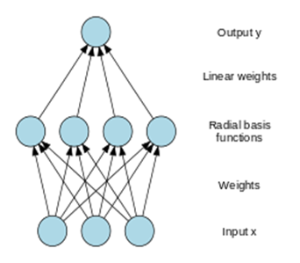
Training Approach and Parameters for RBFNN w/PSO
RBFNN w/PSO
RBFNN
Stage 1
Signal Analysis
LFP and EMG signals datasets (37-59)sec
Stage 2
Fast Fourier Transform
Frequency distribution of LFP signal (1-10)Hz
Pre-tremor (0-1) sec
Tremor onset (20-21)sec
Stage 3
Principal Component Analysis
To Reduce Dimensionality
Fuzzy c means clustering
To Reduce no. of neuron in hidden layer
Stage 4
Stage 5
PSO
Optimize RBF using PSO technique
Issues:
Complexity of Local Field potential signals
Neuron center positions selection as LFP signal has numerous hidden neurons.
Training process and adaptability of the network.
Notes:
Training Approach and parameters to train RBFNN network:
RBFNeural networks are non-linear statistical data modeling tools and can be used to model complex relationships between inputs and outputs or to find patterns in a dataset. RBF network is a type of feed forward neural
network composed of three layers, namely the input layer, a hidden layer with a non-linear RBF activation function and a linear output layer. The design of the RBF neural network mainly consists of two aspects:one is the determination of the parameters of the RBF neurons, namely the centers of the neurons and the Gaussian function widths, and the other is the calculation of the connection weights between the hidden and output layers. Each neuron in the layer stores information from training data which can be called as Training Target. When an input vector is processed by RBFN each neuron compares its Training target to the input and outputs a value between 0 and 1 denoting similarity. A value of 1 indicates that input vector matches the training target and as the distance between the input and training target grows, the value lowers exponentially towards 0. This assigned value is the activation value.
Stage 1: Signal Analysis : LFP and EMG signals are recorded parallel to each other to look for an evident tremor onset triggers and through LPG datasets the tremor were evident between the range 37 to 59 sec and for EMG signals the tremor were evident from 20 sec onwards.
Stage 2: FFT convert signal from original domain to a representation in frequency domain.In this approach the data in original domain is recorded
Stage 3: PCA applied to input data to reduce the dimensionality and transform large set of variables into a smaller one without loosing any information from input data.It creates linear combination of original input.
Stage 4: Fuzzy c clustering to determine center of neuron i.e. to calculate center of vectors which will be explained in subsequent slides
Stage 5 PSO to optimize the mean and standard deviation of radial basis functions which is optimized in terms of sum of squared errors between prediction of network and the desired output. The approach is discussed in detail in subsequent slide.
ISSUES:
Complexity of Local Field potential signals
Selection of neuron center positions is a crucial point as LFP signal has numerous hidden neurons.
Training process and adaptability of the network between patients and with regard to multiple tremor onsets in single patient

Slide 12


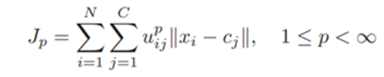
Mapping Parameters for RBFNN w/PSO:
RBFNN w/PSO
Fuzzy C means Clustering
Define a matrix U, start with random walks for cluster centers.
Assign data points a random membership degree for each cluster
Iteratively update the cluster centers and membership degree for each data point until the stopping criteria is met that is the difference between the two iterations is no more than the sensitivity threshold
Else, go to point 2 above
Through iterations minimize objective function
Notes:
Mapping parameter for Fuzzy C Clustering
For RBFF the activation function is Gaussian Function and its computation comprises input vector, center vector, width or ith node, number of neurons in hidden layer, vector weights between hidden layer and output layer and sensitivity adjustment bias. Fuzzy c clustering method is data clustering technique in which a data set is grouped into N clusters with every data point in dataset belonging to every cluster to a certain degree . So, here the goal is to minimize the objective function Jp and to achieve that:
1.Define a matrix U, start with random walks for cluster centers
2.Assign data points a random membership degree for each cluster
3.Iteratively update the cluster centers and membership degree for each data point until the stopping criteria is met that is the difference between the two iterations is no more than the sensitivity threshold
4.Otherwise, go to point 2 above
Through iterations minimize objective function Jp,
Jp is the distance from any given data point to a cluster center weighted by membership of that data point in the cluster.
where; p -any real no.>1;
u_{ij}-degree of membership of x_{i} in the cluster j;
x_{i} - i^{th} piece of N dimensional measured data;
c_{j}- N dimensional center of the cluster;
||.|| any norm expressing similarity between a piece of measuring data and the center.

Slide 13

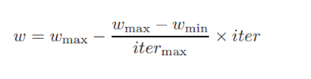

Mapping Parameters for RBFNN w/PSO:
RBFNN w/PSO
Particle Swarm Optimization:
Particle move in d dimensional search space
Initialize population search randomly through V_{id} and X_{id}
Set acceleration constants to ‘2’.
P_{best} - EMG signal analysis i.e. training target -1 and 1.
G_{best} - position that minimize squared prediction error.
Set Inertia weight
Fewer iteration and achieve optimal solution.
iter- current no. of iteration
iter_{max}- max. no. of iteration
Network Output/Fitness Function Calculation:
Mean Squared Error is squared prediction error
Difference between desired output (y) and predicted output (y^)
Where N=20 and iter_{max} 100
Notes:
Mapping Parameter for RBFNN w/PSO
PSO:
Particle move in d dimensional search space. To initialize population search
Set acceleration constants to 2 as per past history, to regulate pull of particle towards best position.
where; Velocity function: v_{id} , -Vector to determine speed and direction of particle, here the velocity is updated by velocity function equation
Position function; x_{id}=x_{id}+v_{id} -Since all the particles try to move towards the best position for optimal fitness, each particle in PSO updates their position to find global optima and position is updated by position function update equation
i= 1,2,…m and d=1,2,...d
w=inertia weight, N =No. Of particles
R1,r2 two uniformly distributed random numbers ranging from 0 and 1.
Pbest is best position of particle among its all positions visited so far. In this application it is EMG reading recorded for Parkinsons patient
Gbest-Position where the best fitness is achieved among all the particles visited so far. In this application it is calculated using mean squared error
Set Inertia weight
Fewer iteration and achieve optimal solution.
iter- current no. of iteration
iter_{max}- max. no. of iteration
Network Output Calculation:
Global best or Mean Squared Error is squared prediction error. Also known as Fitness function used to find Optimal solution. It is square of difference between desired output (y) and predicted output (y^) .
Where N=20 and iter_{max} 100
Prediction method for RBFNN w/PSO is as below:
Initialize population search randomly
Set acceleration constants to 2 as per past history
Calculate Mean Square Error/Fitness Function
Update Particles Velocity and Position, for Optimal Solution or Global best, end search if desired result achieved else continue search and by calculating fitness function using the defined parameters.

Slide 14
Mapping Parameters for RBFNN w/PSO
RBFNN w/PSO
LFP data: Tremor occurring from LFP signals
Basis for input vector recorded using FFT technique i.e each 1 sec window for 10 msec interval and arrived to a frequency range (1-10) Hz
PCA to transform input data into lower dimensionality as 10 dimensional input vector would be computationally expensive.
FCM Clustering to determine initial centers and pattern recognition.
RBFNN optimization using PSO for local search.
Evaluate network output/MSE for best position.
Set Threshold to determine Tremor Status
Notes:
Mapping Parameter for RBFNN w/PSO
This slide list the end to end approach to train RBFN network.
Threshold limit is used to identify and validate the accuracy of network. The Network accuracy is calculated by validating the average network output with a fixed threshold 0 to distinguish tremor or non tremor prediction and considering the output achieved from FFT technique for each 1 sec window the evident tremor recorded by EMG recordings.

Slide 15
Issues and Limitation in Mapping for RBFNN w/PSO
RBFNN w/PSO
Designed approach uses reduced number of neurons in the hidden layer.
No prediction are possible during no tremor activity periods.
Need to evaluate robustness of technique on different patients.
Explore further scope to improve detection accuracy of designed network.
Possibility of False positive detection leading to DBS device trigger.
Notes:
Issue and Limitation in mapping for RBFNN w/PSO

Slide 16

Conclusion - FNN w/PSO
Iris Species Classification
PSO → inspired by → flocks of birds && schools of fish.
Each FNN (i.e., particle) → regions of a brain
∑ FNN → linguistic center of a brain
Simplistic calculations gradient descent
Achieved 97% species identification using a standard dataset
Notes:
Conclusion- FNN w/PSO

Slide 17
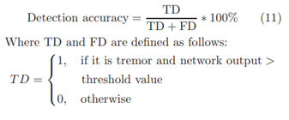

Conclusion-RBFNN w/PSO
RBFNN w/PSO
LFP signals are used to train the network.
Training and validation of average output is achieved by EMG recording
Performance evaluation of designed network in terms of Detection Accuracy:
Achieved detection accuracies of up to 89%.
Defined training Target of RBFNN is 1 for tremor onset pattern and -1 for a non-tremor pattern.
If network output is approaching 1, then it can be interpreted as detection of tremor onset.
Notes:
Conclusion -RBFNN w/PSO
Since here an input vector is processed by RBF layer and assigned a similarity score and then it is distinctly characterised by a set of output nodes where one node is assigned a positive weight and the other a negative weight. Thereby the training target in this application is defined -1 and 1 to understand the tremor pattern.

Slide 18
Thank you for your attention!
References
He Zhenya et al., "Extracting rules from fuzzy neural network by particle swarm optimisation," 1998 IEEE International Conference on Evolutionary Computation Proceedings. IEEE World Congress on Computational Intelligence (Cat. No.98TH8360), 1998, pp. 74-77, doi: 10.1109/ICEC.1998.699325.
J. Kennedy, "The particle swarm: social adaptation of knowledge," Proceedings of 1997 IEEE International Conference on Evolutionary Computation (ICEC '97), 1997, pp. 303-308, doi: 10.1109/ICEC.1997.592326.
Dohnal, M., 1983. Linguistics and fuzzy models. Computers in industry, 4(4), pp.341-345.
Wu, Defeng & Warwick, Kevin & Ma, Zi & Gasson, Mark & Burgess, Jonathan & Pan, Song & Aziz, Tipu. (2010). Prediction of Parkinson's disease tremor onset using radial basis function neural network based on particle swarm optimization. International journal of neural systems. 20. 109-16. 10.1142/S0129065710002292.
Notes:
Conclusion (1 minute)

Slide 20
Fundamentals of Metaheuristics and Parameters
Objective function:
Particle position:
Particle velocity:
Position increment:
Velocity increment:
Local optima position:
Global optima position:
Global optima position:
Inertia weight constant:
Cognitive coefficient:
Social coefficient:
Notes:
Fundamentals of Metaheuristics and Parameters (1 minute)
https://latexeditor.lagrida.com/
\overline{x}^i = (x_1^i, x_2^i, \dots, x_D^i)
\overline{v}^i = (v_1^i, v_2^i, \dots, v_D^i)
\overline{x}^i(t+1) = \overline{x}^i(t) + \overline{v}^i(t+1)
\overline{v}^i(t+1) = w\,\overline{v}^i(t) + c_1r_1\left(\overline{p}^{*i} - \overline{x}^i(t)\right) + c_2r_2\left(\overline{g}^* - \overline{x}^i(t)\right)
f:\mathbb{R}^D\to \mathbb{R}

